Slide 1
Flight Route Optimization with Dijkstra’s and A* Algorithm
Team Elly Ma, Sharon Lyu, Maggie Shi
Notes:
Color Theme: https://store.line.me/themeshop/product/3d7e19bf-e259-46eb-afa4-715a4fe8be69/en?from=theme
Overview: problem overview, what his project can help with
Data: api, first trial 10 cities with direct flights, second trial 20 cities with less direct flights(reduced direct flight from the east coast to west coast)
Algorithm: Intro of the two algorithms, difference (we used real flight data sourced from Amadeus API, cleaned the source data, and built Dijkstra to calculate shortest path considering exact weights and A* using heuristic functions that combines the distance and flight duration.) We will then present the result comparing the speed of the two algorithm when weight of the heuristic functions changes.
Result: visualization of the results
Limitation
Conclusion

Slide 2
Project Overview
Dijkstra’s VS A* Algorithm
Background
Methodology
Result
Conclusions
Flight route optimization
Dijkstra’s Algorithm
A* Algorithm
Source Data
Algorithms
Algorithm Comparisons
Compare Dijkstra and A* results
Notes:
In this presentation, our main focus is to compare Dijkstra and a* algorithms. We will start with the background of how we get the idea of flight route optimization, a breif introduction of the D and A algorithm. Then Sharon will show to you our method to complete the project. How we obtained the source data and ideas to build the algo.Then Elly will present you the results of our project. Finally, we will share our findings in the conclusion.

Slide 3
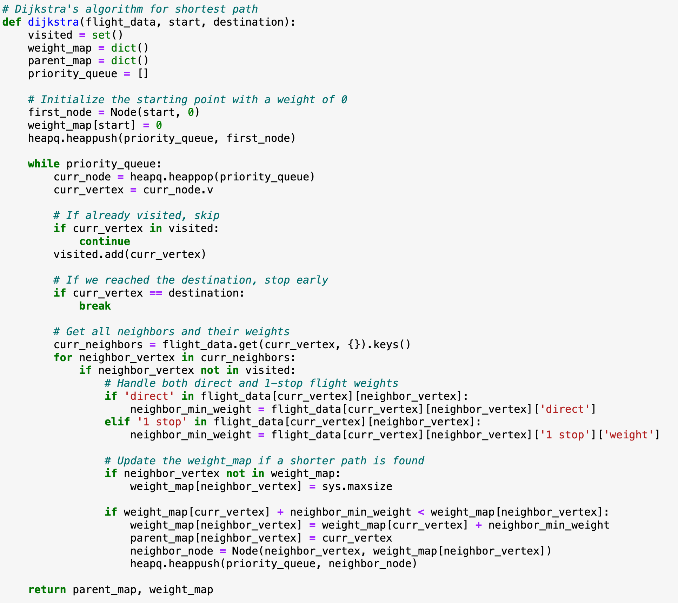
Background: Flight Planning with Dijkstra’s and A* Algorithm
How Dijkstra works for flight planning
Dijkstra
Does not use heuristics.
Only considers the cost from the start node to the current node. Ensuring it always explores the node with the smallest known cost so far.
Notes:
As we are approaching winter break, we noticed a lot of peers are planning to travel the states. It’s really hard to find the cheap flight tickets with short flying hours when you need to make multiple stops.Therefore, we selected Flight route optimization problem to compare the two algorithms. Both graph search algorithms finds the shortest path between nodes in a graph. However, they have key differences in how they prioritize nodes during the search: The screenshot on the right is our dijkstra code:
Dijkstra's Algorithm:
It Does not use heuristics.
Only considers the cost from the start node to the current node, in our case, the cost is the flight ticket price. The algo always explores the node with the smallest known cost so far.

Slide 4
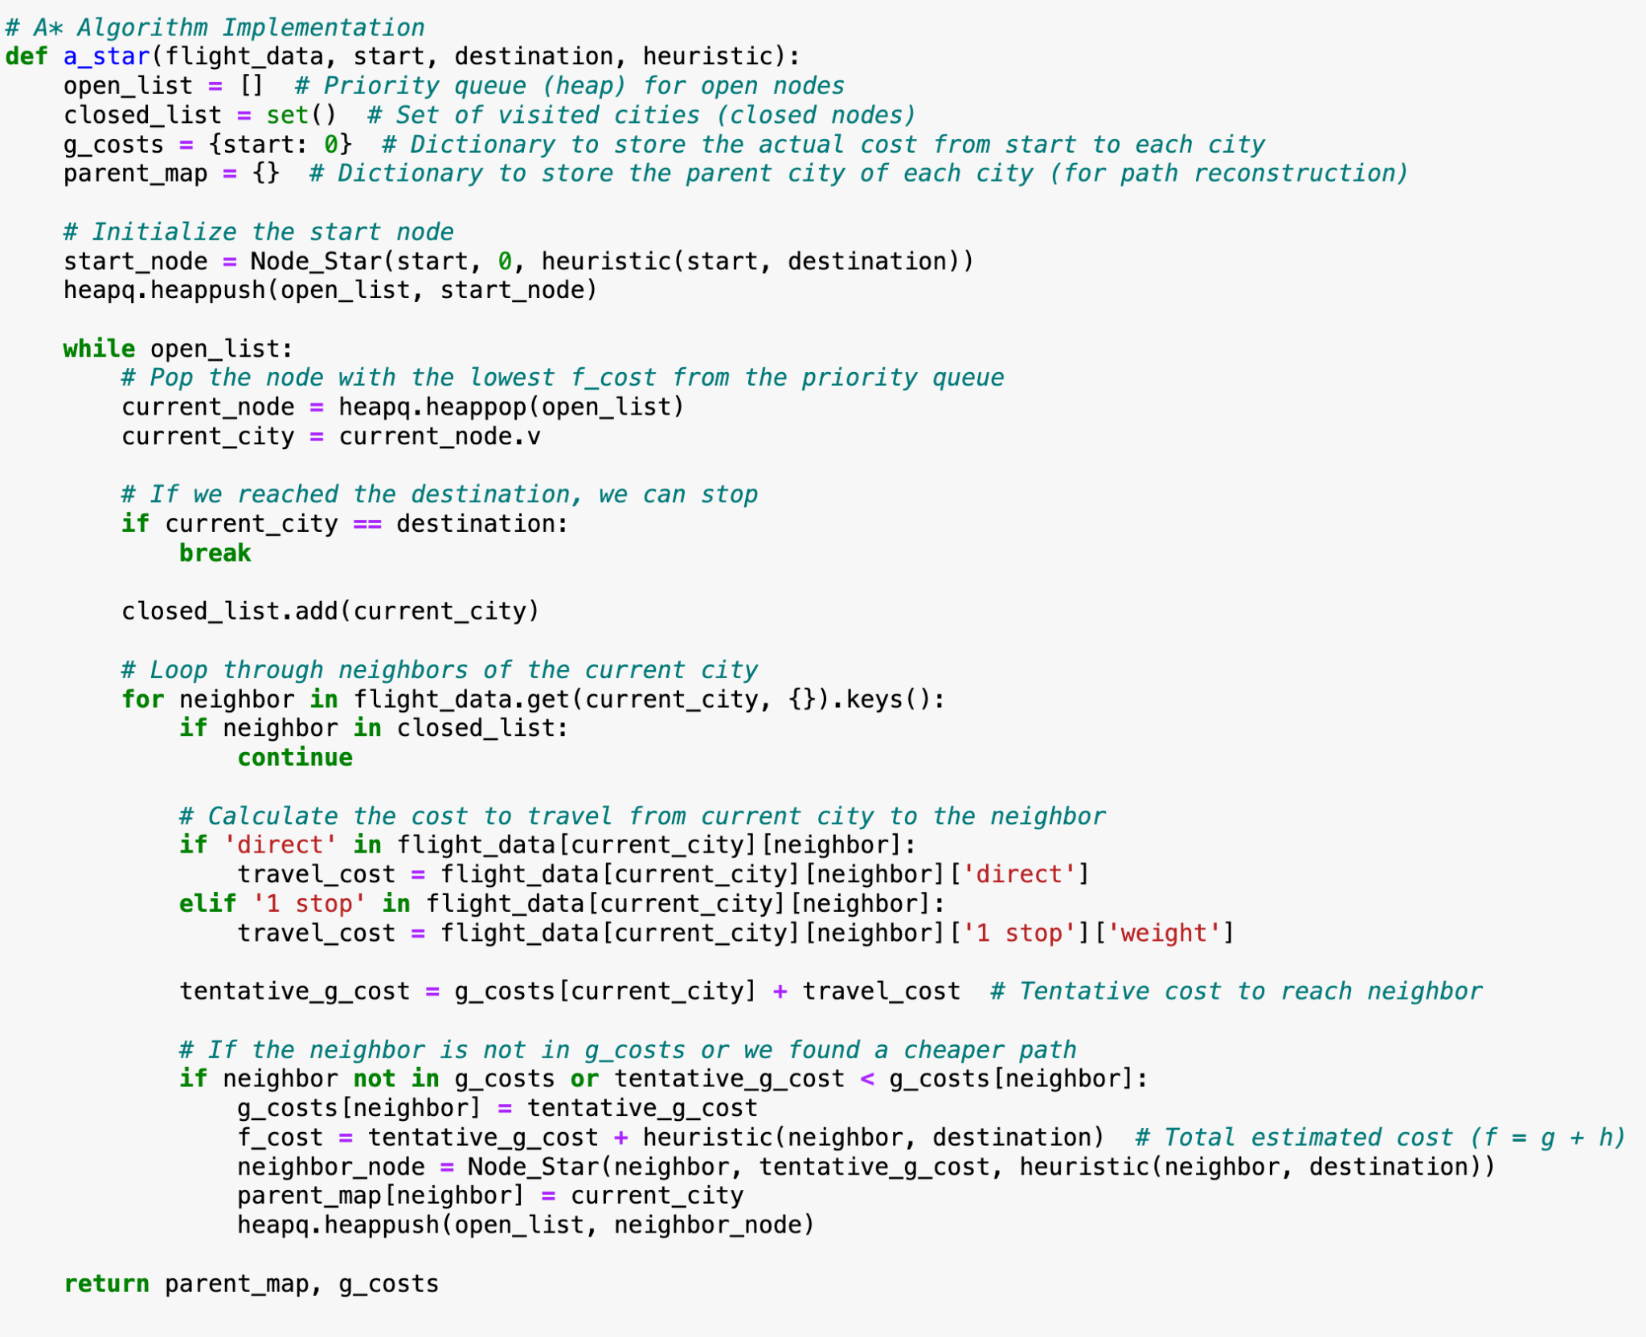
Background: Flight Planning with Dijkstra’s and A* Algorithm
How A* works for flight planning
A*
Does not use heuristics.
Only considers the cost from the start node to the current node. Ensuring it always explores the node with the smallest known cost so far.
Uses a heuristic function to estimate the cost
Combines cost so far and estimated cost to goal into a priority value
The heuristic guides the search toward the goal more efficiently.
Notes:
As for a* algorison, as you can see in the screenshot of our codes on the right
The A Algorithm*:
Uses a heuristic function to estimate the cost from the current node to the goal
It Combines cost so far and estimated cost to goal into a priority value:
So the search towards the goal will be more efficiently.
So what is a heuristic function?

Slide 5
What is a Heuristic Function?
Definition: A heuristic function estimates the cost/distance to the goal.
Purpose: Guides search algorithms, reducing unnecessary exploration.
Applications: A* Algorithm:
Combines the heuristic (h(n)) with the cost-so-far (g(n)) to prioritize nodes: f(n)=g(n)+h(n)f(n) = g(n) + h(n)f(n)=g(n)+h(n)
The heuristic ensures the search is goal-oriented.
Notes:
A heuristic function estimates the cost/distance to the goal.
Its Purpose is to guides search algorithms,therefore reducing unnecessary exploration.
As we mentioned previously, our A* Algorithm:
Combines the heuristic with the cost-so-far to prioritize nodes: therefore the search is goal-oriented
Next Sharon will walk you through our methodology on how we obtain the source data by API

Slide 6
Methodology: API
Definition:
API stands for Application Programming Interface.
It is a set of rules and protocols that allows one application to interact with another.
Benefits:
Enables integration between systems.
Simplifies complex tasks by abstracting functionality.
Facilitates scalability and reusability.
Example:
Amadeus API: Provides travel data, including flights, hotels, and destinations, for building travel applications.
Notes:
APIs are essential tools for modern software development. Let me begin with the definition.In our project, we used the Amadeus API (pronounced aa-muh-day-uhs). This API is widely used in the travel industry and provides access to various types of travel-related data, such as flights, hotels, and destinations.For our group, we primarily used the Amadeus API to fetch flight data, which formed a key part of our project.

Slide 7
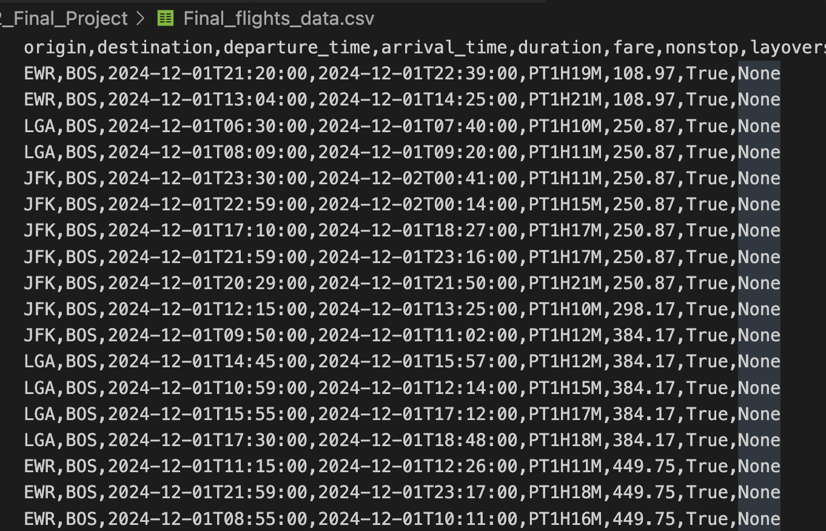
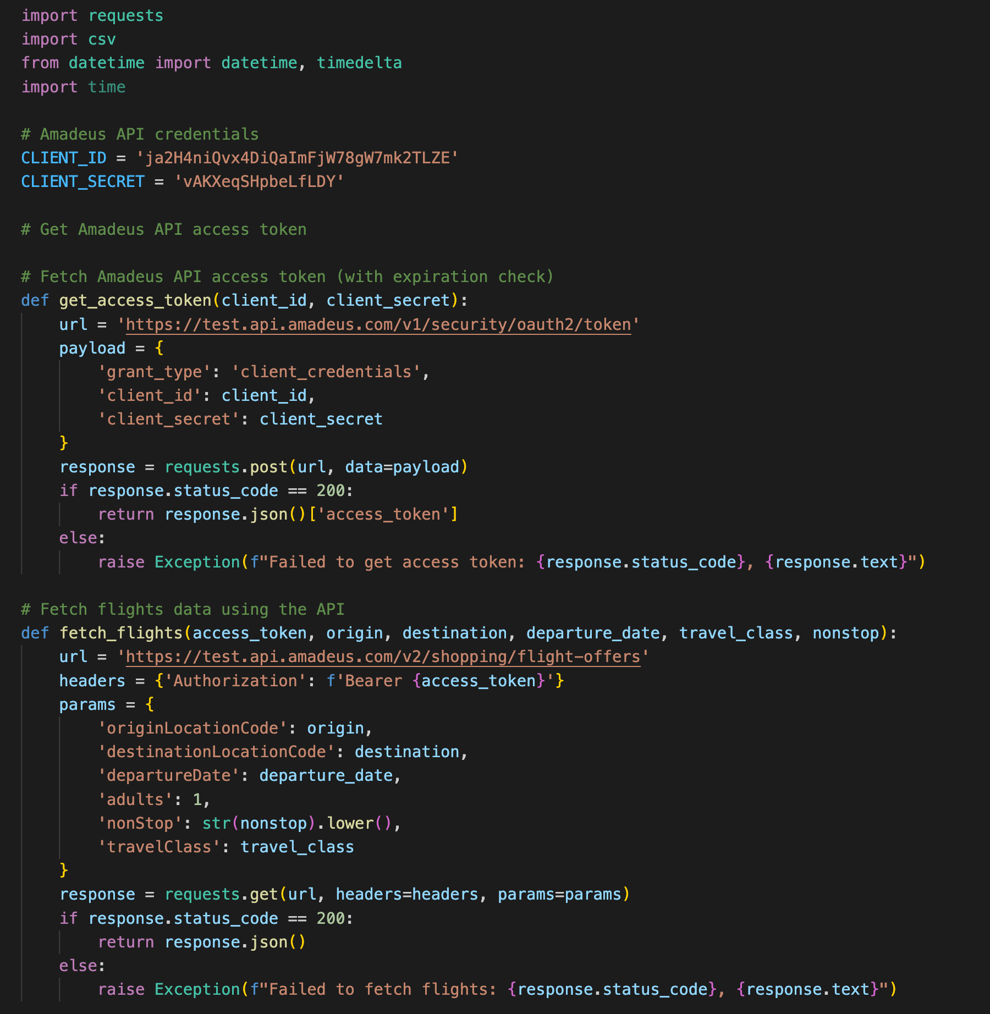
Data Retrieval with Amadeus API
Connect to the API Endpoint:
Utilize Python Requests library for HTTP requests.
Obtain an API token via client credentials.
Send API Requests:
Use GET Methods for fetching flight data.
Include required parameters (e.g., city codes, date).
Handle API Responses:
Convert JSON response to Python data structures.
Extract relevant fields (e.g., departure cities, dates, fares).
Successfully fetched 20,000+ flight records across 20 cities.
Notes:
In this section, I will walk through how we connected to and interacted with the API for our project. We began by connecting to the API endpoint using the Python Requests library, a tool commonly used for handling HTTP requests. Next, we sent API requests, primarily using GET methods to fetch the flight data we needed. These requests included specific parameters such as city codes, dates, and fares to ensure the data matched our project requirements.Once we received the API responses, we converted the JSON data into Python data structures like dictionaries and lists, making it easier to process and analyze. Finally, we successfully fetched over 20,000 flight records spanning across 20 cities. This dataset was crucial in building the core functionality of our project.

Slide 8
Methodology: Data Collection & Dataset
By Amadeus API
Departure Arrival Locations
Fares
06
01
Flight Durations
Stop status None
05
02
Departure/Arrival Date/Time
04
03
Travel class Economy
Notes:
This page highlights the specific data we collected using the Amadeus API. The data we collected includes:Departure and arrival locations, Flight durations, Departure and arrival dates, Departure and arrival times, Fares.To better compare the two algorithms, we expanded our dataset to cover 20 major U.S. cities for a more comprehensive analysis. This allowed us to work with a more complex and diverse dataset to ensure robust comparisons.

Slide 9
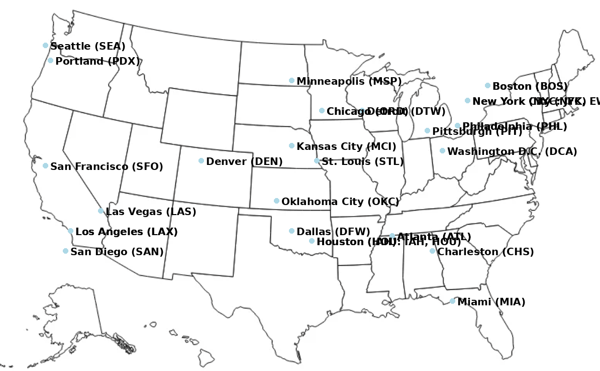
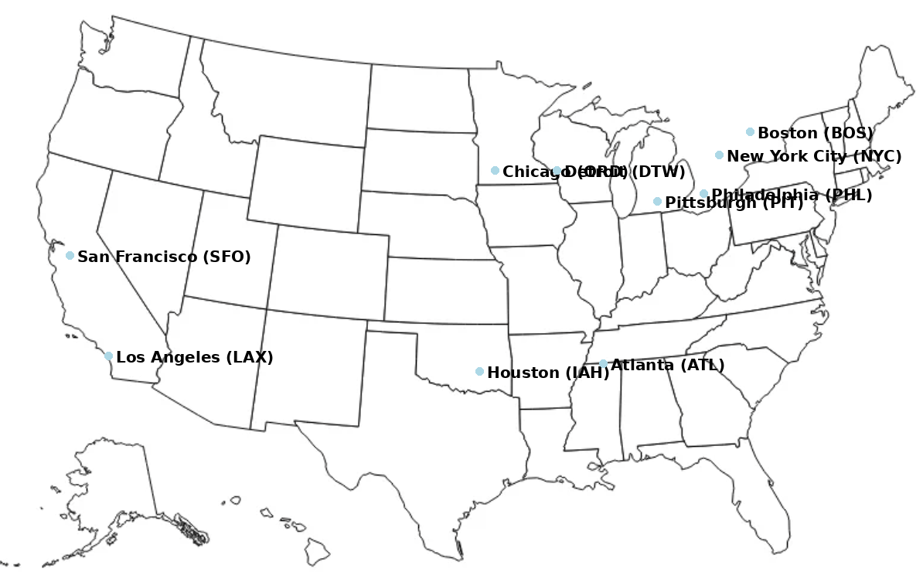
Data Sources: 10 Airports to 20 Airports
Notes:
This slides shows the coverage of the first data set which are 10 cities, then we expanded to 20 cities to cover east middle and west regions.

Slide 10
Methodology: Different Optimizations
1
2
3
Flight Duration Data
Flight Fare Data
Combination of Flight Duration & Fare Data
Optimizing for Travel Time
Optimizing for Cost
Optimizing for a Trade-Off Between Time and Cost
Notes:
After collecting the dataset, we performed some data cleaning to ensure its quality. This included removing invalid flights, renaming columns for consistency, and eliminating duplicate entries. Next, we developed three models to compare the results: The first model focused on flight duration, The second model analyzed flight fares, The third model combined both flight duration and fare data.These models allowed us to optimize the algorithms and make meaningful comparisons based on different criteria.

Slide 11
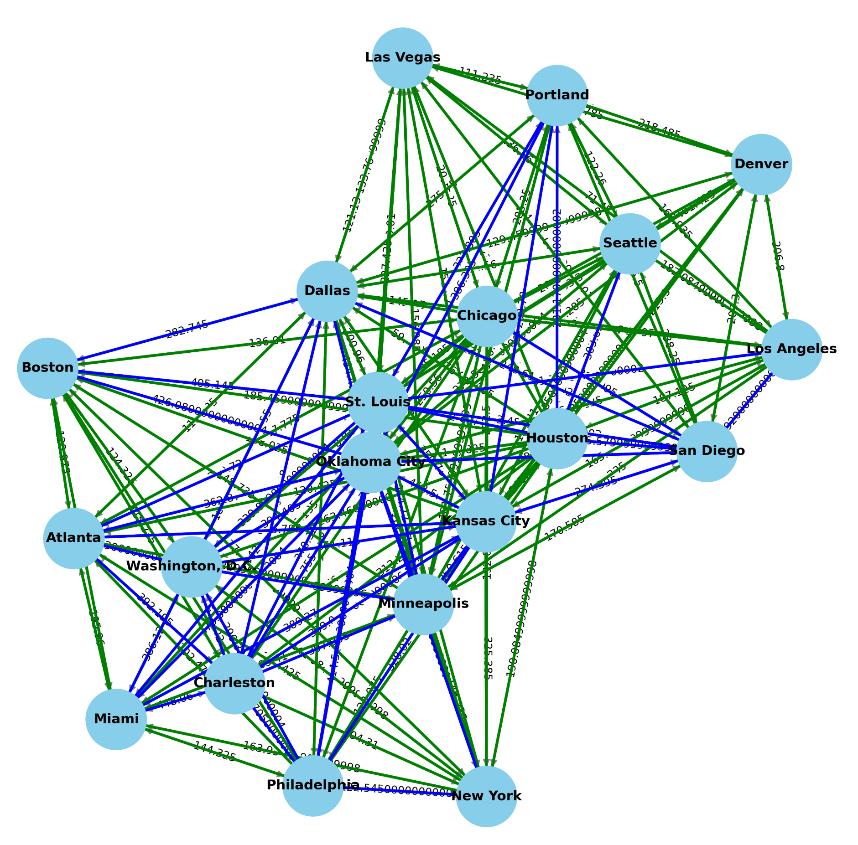
Graphical Representation of Cities and Flights
Structures of Flight Graph
Vertices
Vertices represent cities
Edges
Edges represent flights between cities
Arrows
Arrows represent direction of flights
Flight Routes Between Cities - Duration Data
Notes:
First we started by building graphical representations of the flight graphs of the three datasets
This is the flight graph showing the duration flight data
The graph consist of three parts
Vertices: represents cities
Edges: represent flight between cities, where green line shows the direct flight and blue line shows flights that have overlays, and the labels on the edges are the duration of flights
Arrows: represent the direction of the flight

Slide 12
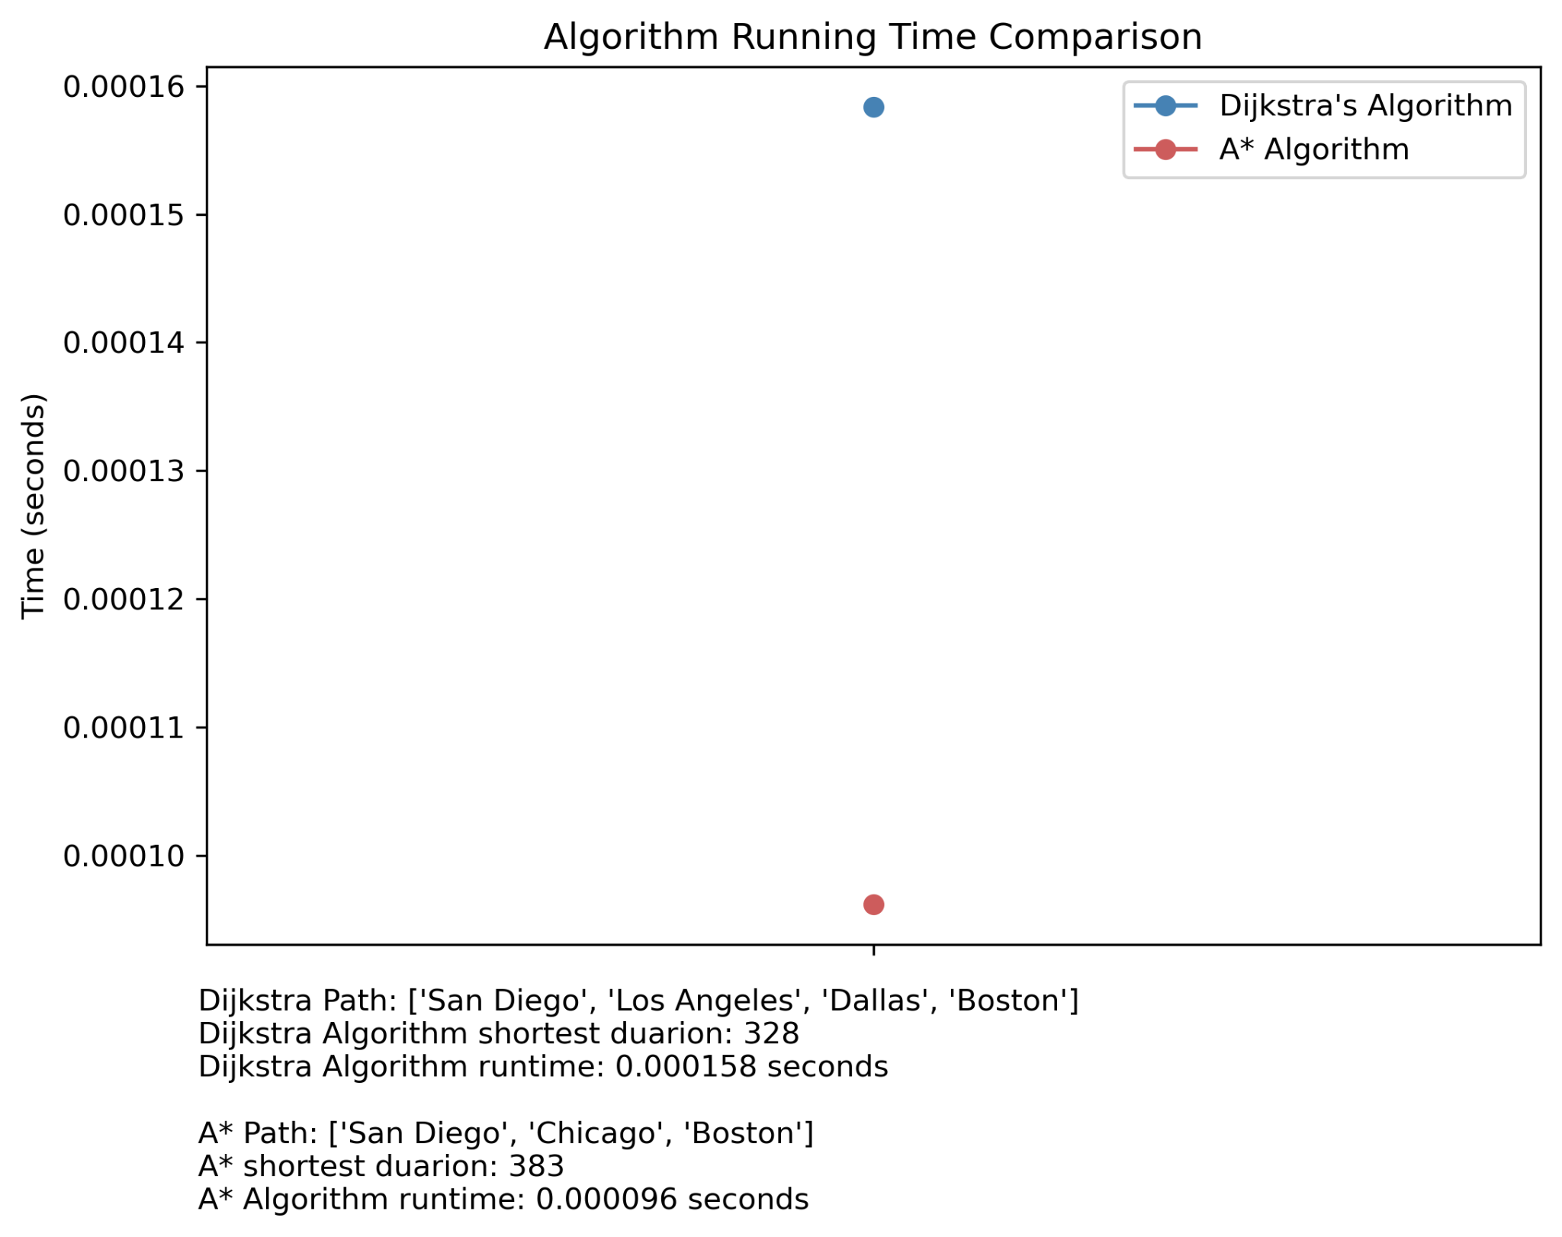
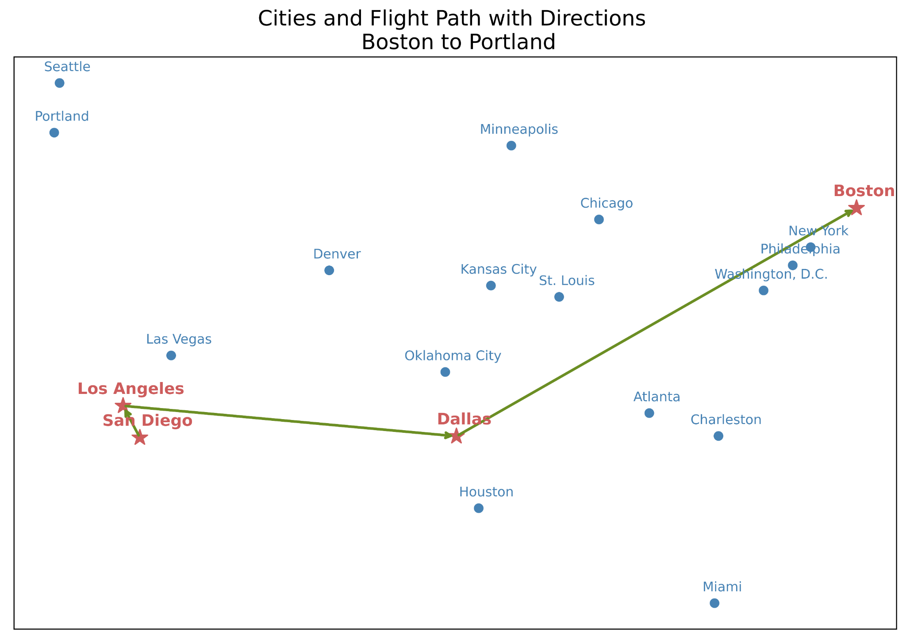
Sample Flight Paths and Comparison
San Diego
Boston
Notes:
Here on the left we have a sample flight path using A* from san diego to boston
We can see that it when starting at san diego, a* went through los angeles, and dallas, and reached the destination which is boston
We can see for this particular origin and destination, a* runs faster than dijkstra's

Slide 13
Experiment
Setup and Steps
Run Dijkstra’s algorithm and A* algorithm from each west coast city to each east coast city on three sets of data
West coast cities: ['Los Angeles', 'Las Vegas', 'Seattle', 'San Diego', 'Denver', 'Portland']
East coast cities: ['New York', 'Boston', 'Washington, D.C.', 'Philadelphia', 'Miami', 'Charleston', 'Atlanta']
Datasets: ['flight_duration', 'flight_fare', 'flight_weight']
Record Dijkstra’s and A* algorithm runtime, paths, duration, price, and weighted duration and price, and count
Compare results for the two algorithms

Slide 14
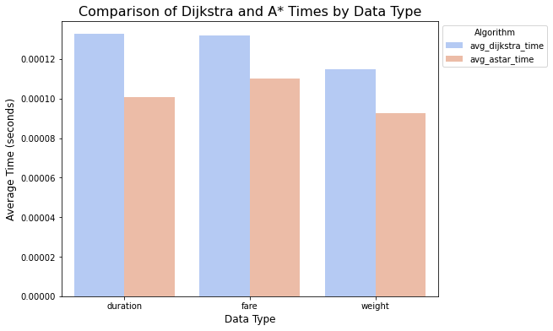
Results: Time Comparison
Notes:
This graph show the time comparison of the dijkstra and a*
Red bar denotes the time that a* takes
Blue bar denotes the time that dijkstra takes
When running the three different datasets respective on the two algorithms, we see that a* on average takes less time to get to the destination than dijkstra

Slide 15
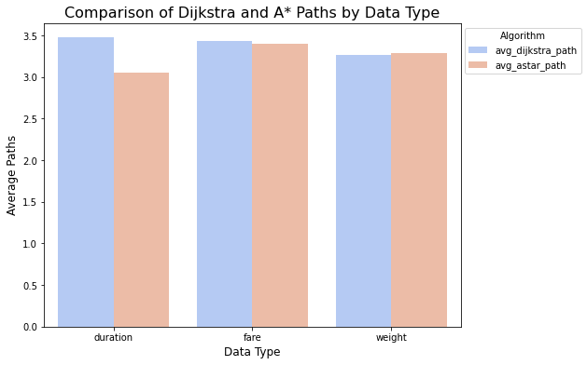
Results: Path Comparison
Notes:
This graph represents the same thing but compares the average paths the algorithms take
Red: a*
Blue: dijkstra
The average paths that both two algorithm take do not show much difference, which take value from 3 to 3.5
This is due to the limitation of the topic that we chose

Slide 16
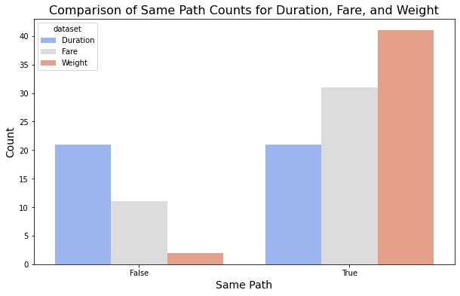
Results: Comparison by Same Path Counts
Notes:
This graph shows the comparison of whether the two algorithms give the same paths when using the same dataset
One thing to notice here is the red bar, which is the weighted factor of 50% duration and 50%
The two algorithms give more overlapping paths for when the input dataset is using a combination of multiple factors

Slide 17
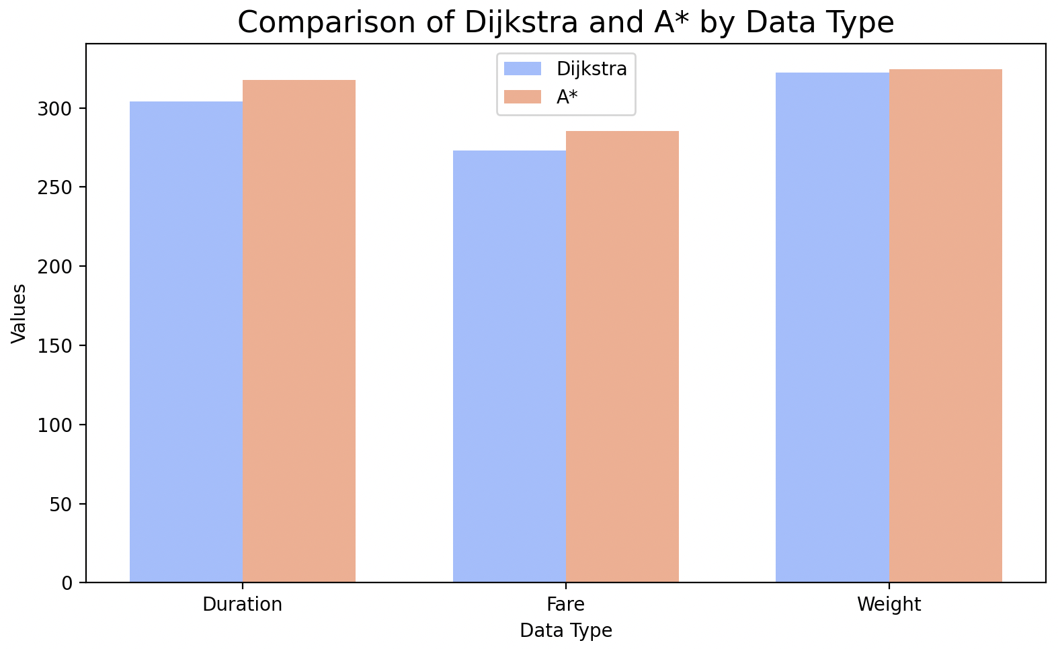
Results: Comparison by Average Optimal
Notes:
Last but not least, this graph shows a clear difference of the dijkstra and a* when finding the shortest path.
We can see because that the dijkstra’s algorithm take only the input factor and compare this input factor to search, it will always give the shortest path based on what the input factor is.

Slide 18
Conclusion:
Data Type | Dijkstra's Result | A* Result
Flight Duration | Shortest duration path (optimal solution) | Shortest duration path (optimal solution), potentially faster
Flight Fare | Cheapest fare path (optimal solution) | Cheapest fare path (optimal solution), potentially faster
Combination (Duration + Fare) | Optimal path based on combined weight (if defined) | Optimal path based on combined weight (if defined), potentially faster
Notes:
Dijkstra's Algorithm guarantees optimal results, but may be slower in large datasets because it explores all possible paths.
A* can be faster, especially if a well-designed heuristic is used, since it avoids unnecessary exploration of paths that don't look promising based on the heuristic.
both algorithms will ultimately return the same optimal solution for the given problem, provided the criteria are well defined.

Slide 19
Thank You
Team Elly Ma, Sharon Lyu, Maggie Shi
Notes:
Color Theme: https://store.line.me/themeshop/product/3d7e19bf-e259-46eb-afa4-715a4fe8be69/en?from=theme

